Slide 1
CS 5187: Vision and Image
Lecture 1-3
Edge Detection
Dr. Dapeng Oliver Wu
City University of Hong Kong
Department of Computer Science
Semester A, 2026/27

Slide 2
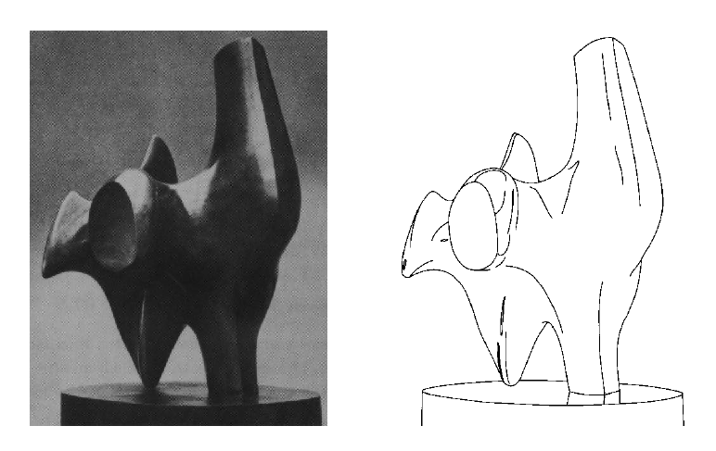
Edge detection
Convert a 2D image into a set of curves
  Extracts salient features of the scene
  Contain higher level semantic info, than pixels
TexPoint fonts used in EMF.
Read the TexPoint manual before you delete this box.: AAA

Slide 3
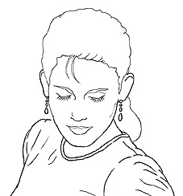
Edge detection
Goal: Identify visual changes (discontinuities) in an image.
Intuitively, semantic information is encoded in edges.
What are some ‘causes’ of
visual edges?
Source: D. Lowe

Slide 4
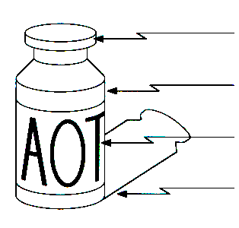
Origin of Edges
surface normal discontinuity
depth discontinuity
surface color discontinuity
illumination discontinuity
Edges are caused by a variety of factors

Slide 5
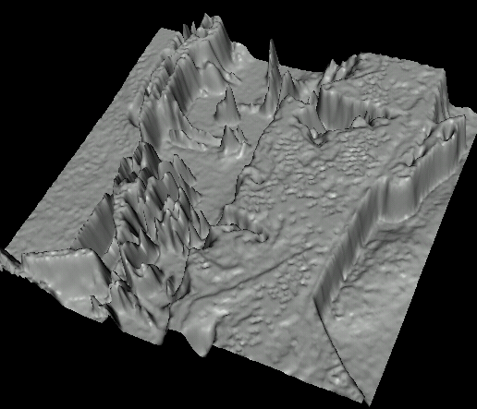
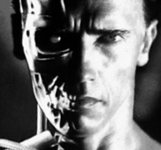
Images as functions…
Edges look like steep cliffs

Slide 6
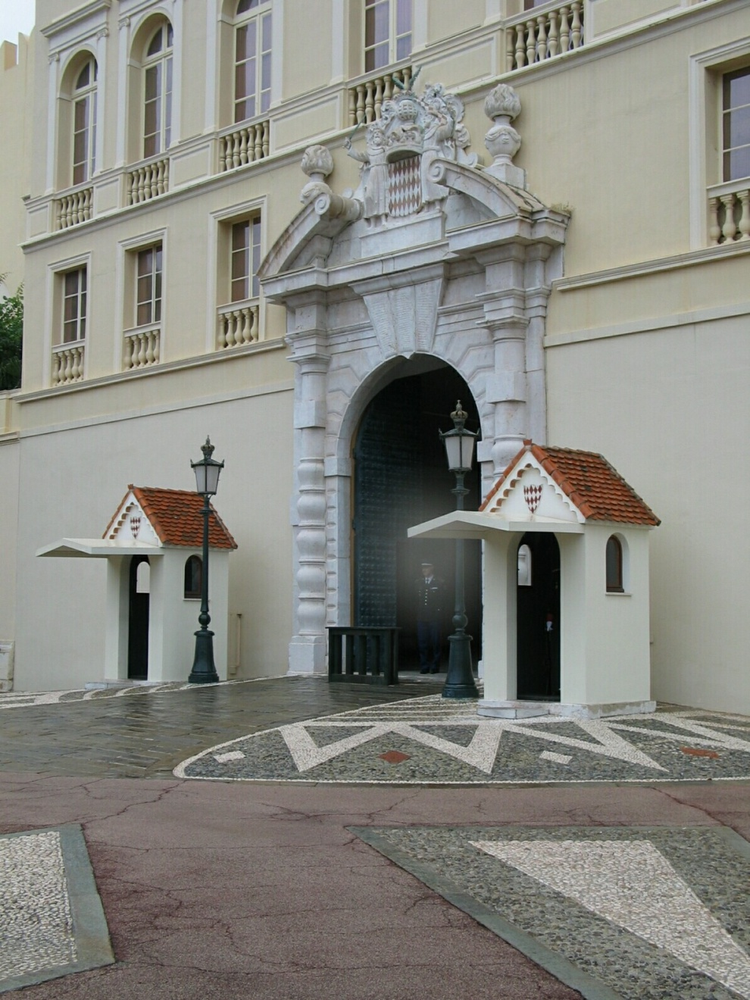
Closeup of edges
Source: D. Hoiem

Slide 7
Closeup of edges
Source: D. Hoiem

Slide 8
Closeup of edges
Source: D. Hoiem

Slide 9
Closeup of edges
Source: D. Hoiem

Slide 10

Characterizing edges
An edge is a place of big change in the image intensity function
intensity function
(along horizontal scanline)
image
first derivative
edges correspond to
extrema of derivative
Source: L. Lazebnik

Slide 11
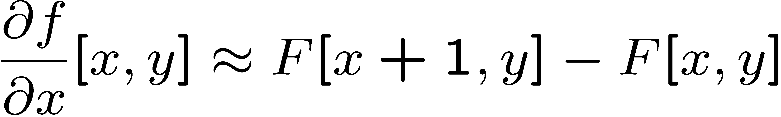




Image derivatives
How can we differentiate a digital image F[x,y]?
  Option 1: reconstruct a continuous image, f, then compute the derivative
  Option 2: take discrete derivative (finite difference)
How would you implement this by a linear filter?
1 | -1
 | -1
 | 1
:
:
Source: S. Seitz

Slide 12
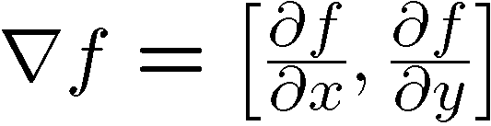
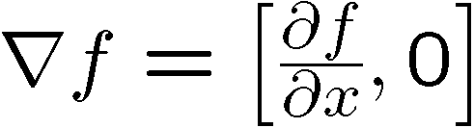
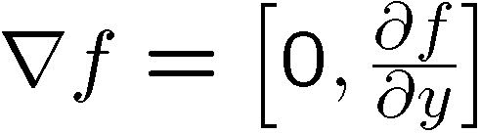
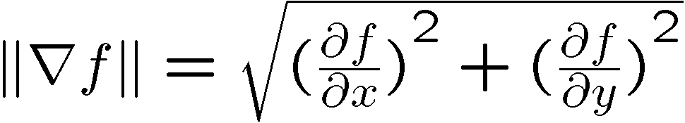
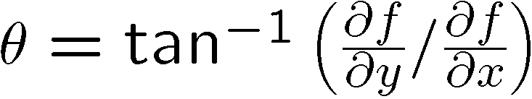
Image gradient
The gradient of an image:
The gradient points toward the direction of the biggest increase in intensity
The edge strength is given by the gradient magnitude:
The gradient direction is given by:
Source: Steve Seitz

Slide 13
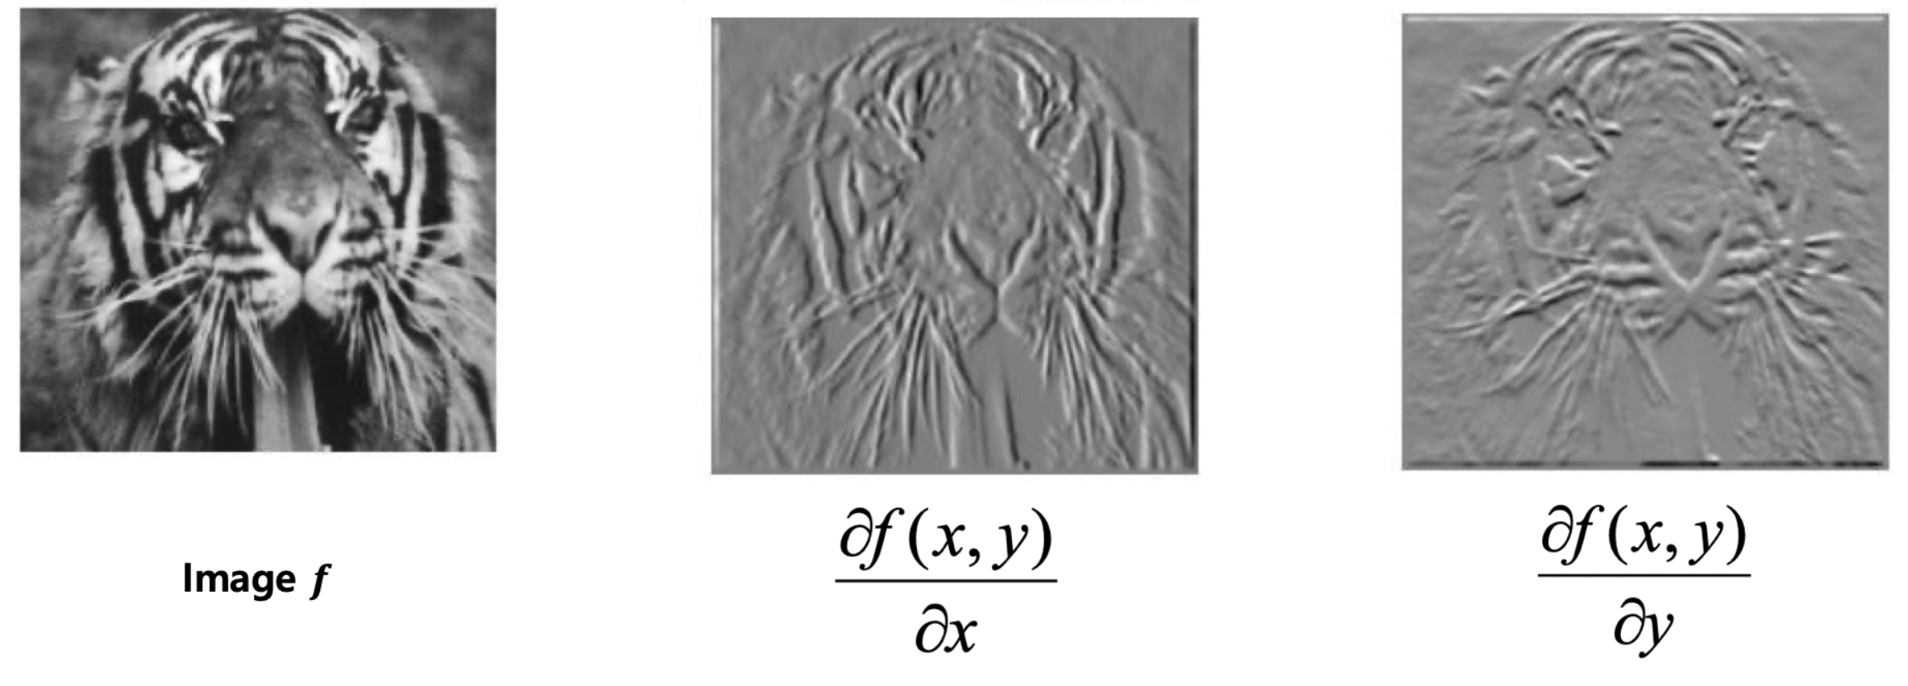
Image gradient
Source: L. Lazebnik

Slide 14


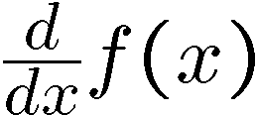
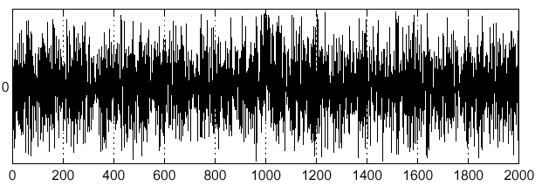
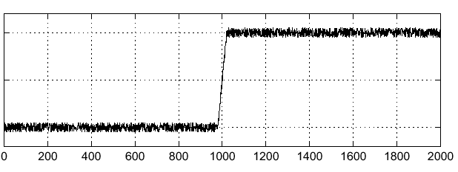
Effects of noise
Noisy input image
Where is the edge?
Source: S. Seitz
Notes:
How to fix?

Slide 15
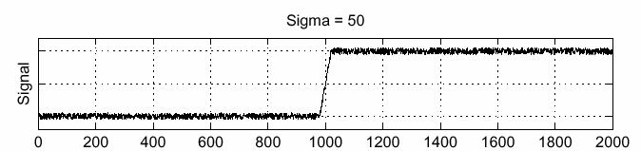
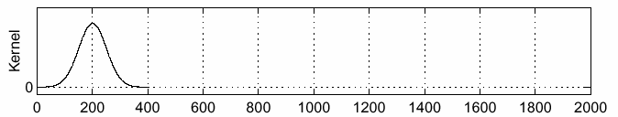
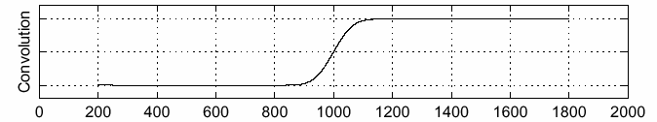
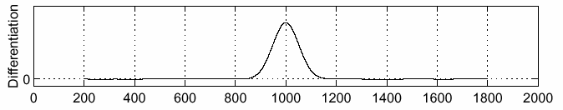
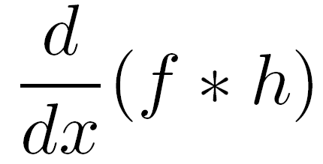
Solution: smooth first
f
h
f * h
To find edges, look for peaks in
Source: S. Seitz

Slide 16
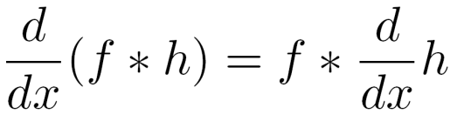
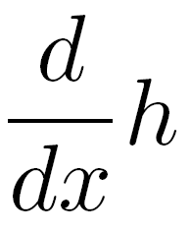
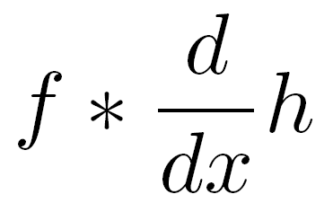
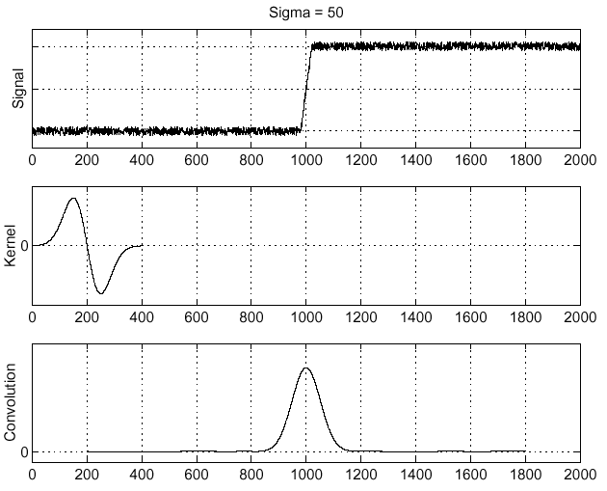
Associative property of convolution
Differentiation can be implemented by convolution, and convolution is associative:
This saves us one operation:
f
Source: S. Seitz

Slide 17
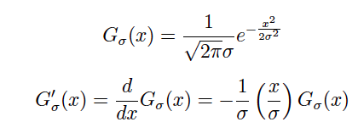
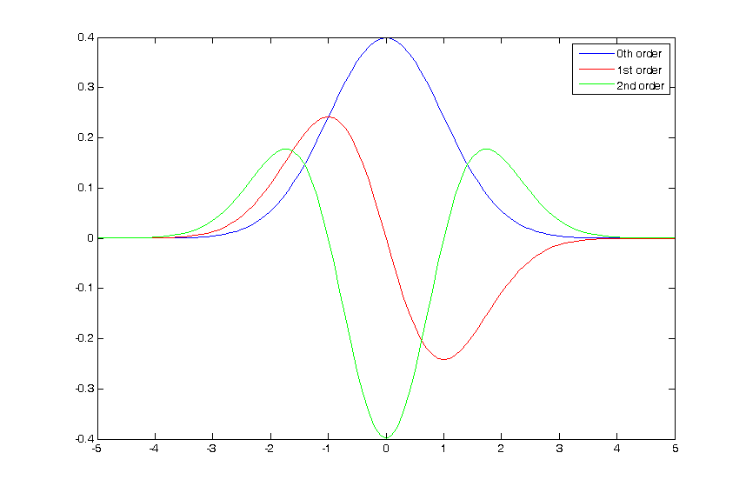
The 1D Gaussian and its derivatives

Slide 18
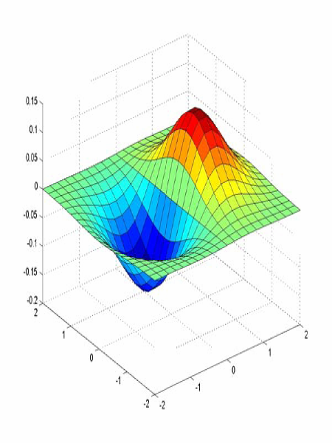
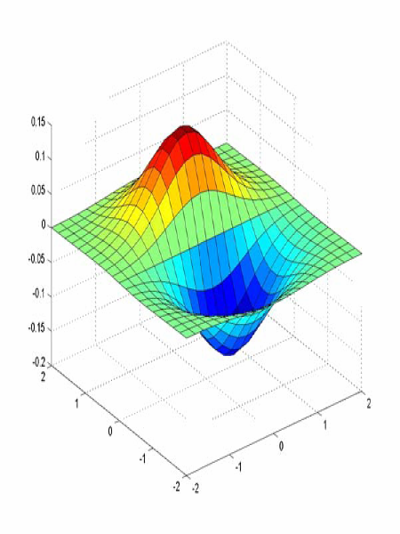
Derivative of Gaussian filter
x-direction
y-direction

Slide 19



The Sobel operator
Common approximation of derivative of Gaussian
-1 | 0 | 1
-2 | 0 | 2
-1 | 0 | 1
1 | 2 | 1
0 | 0 | 0
-1 | -2 | -1
  The standard defn. of the Sobel operator omits the 1/8 term
    doesn’t make a difference for edge detection
    the 1/8 term is needed to get the right gradient magnitude

Slide 20
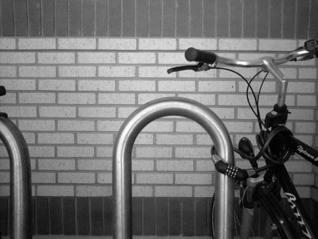
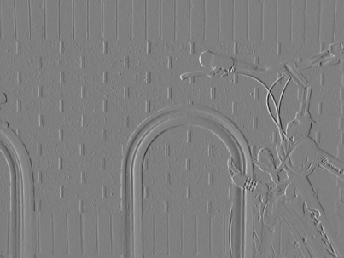
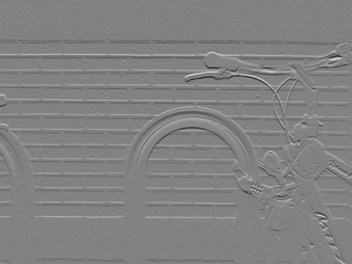
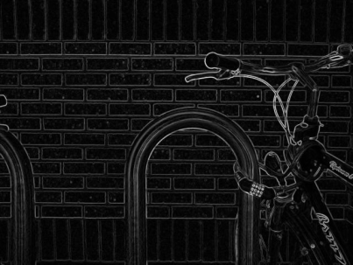

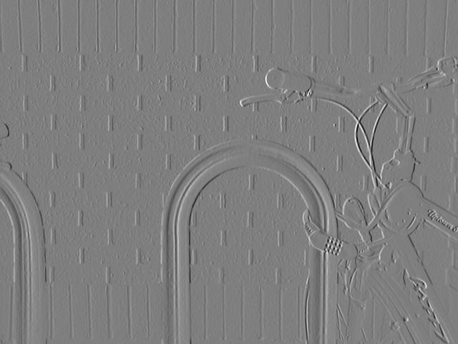
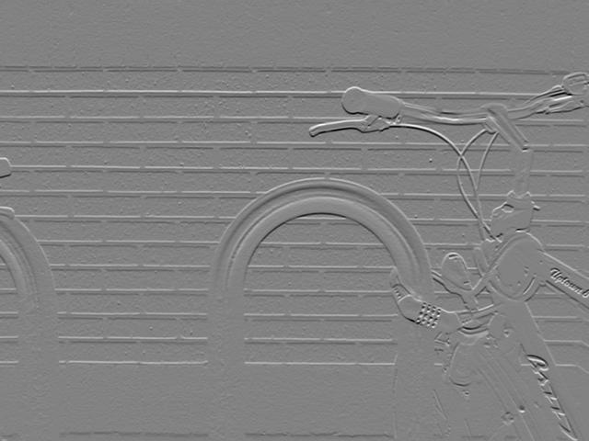
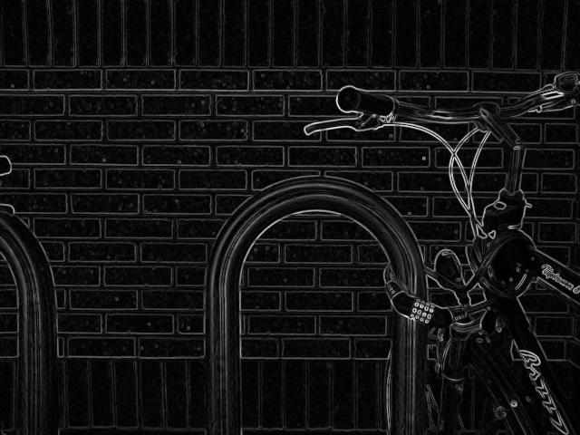
Sobel operator: example
x-gradient
y-gradient
gradient magnitude
Source: Wikipedia

Slide 21
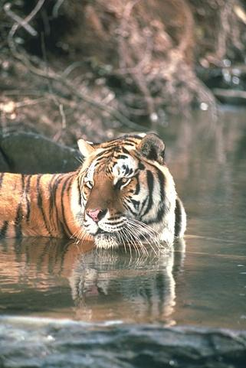
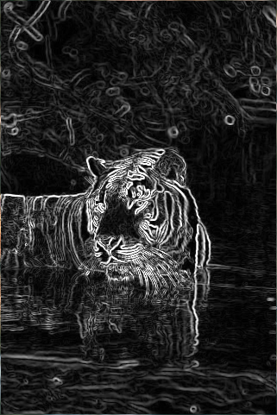
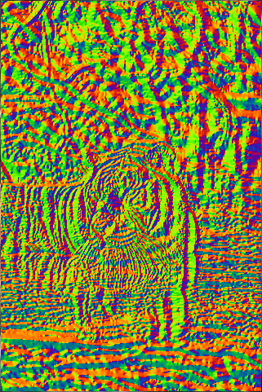
Sobel operator
Original
Magnitude
Orientation

Slide 22
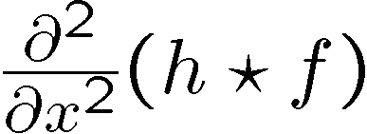
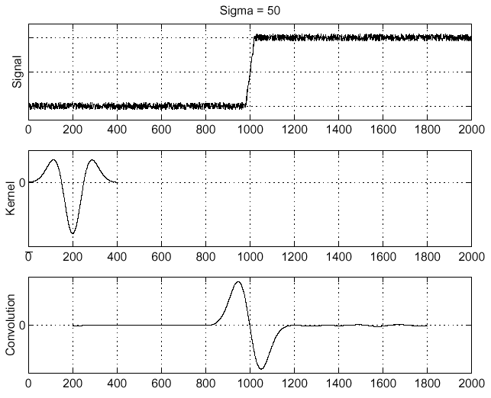

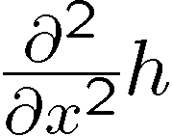
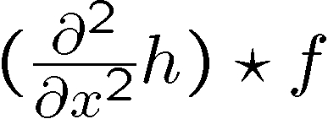
Laplacian of Gaussian (LoG)
Consider
Laplacian of Gaussian
operator
Where is the edge?
Zero-crossings of bottom graph

Slide 23
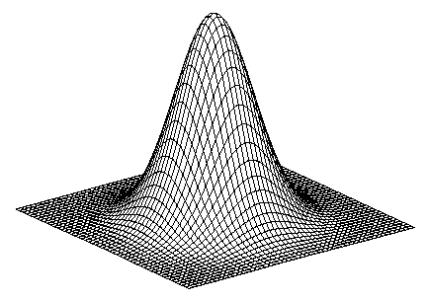
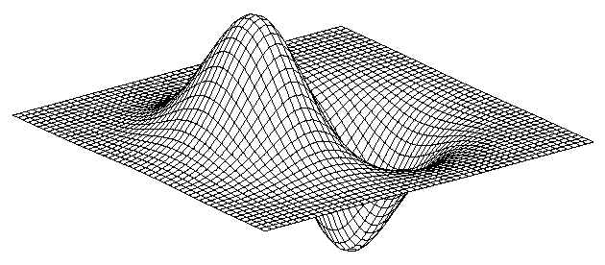
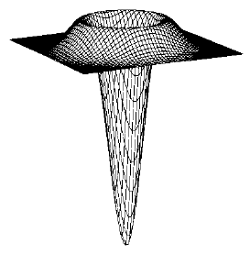
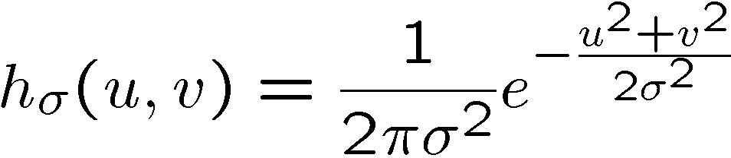
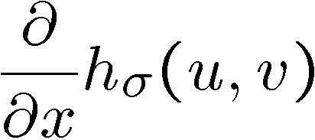
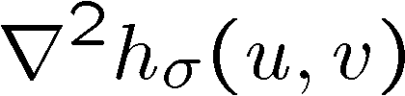

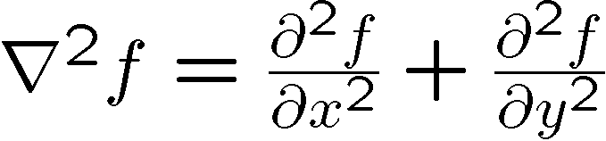
2D edge detection filters
Laplacian of Gaussian
Gaussian
derivative of Gaussian
is the Laplacian operator:
Notes:
Blurring an image with a Gaussian and then taking its Laplacian is equivalent to convolving directly with the Laplacian of Gaussian (LoG) filter

Slide 24
Laplacian for Edge Detection

Slide 25
Using the LoG Function
The LoG function will be
  Zero far away from the edge
  Positive on one side
  Negative on the other side
  Zero just at the edge
Therefore, it can be used as an edge operator
BUT, is this good enough?

Slide 26
Designing an edge detector
Criteria for a good edge detector:
  Good detection: the optimal detector should find all real edges, ignoring noise or other artifacts
  Good localization
    the edges detected must be as close as possible to the true edges
    the detector must return one point only for each true edge point
Cues of edge detection
  Differences in color, intensity, or texture across the boundary
  Continuity and closure
  High-level knowledge
Source: L. Fei-Fei

Slide 27
Canny edge detector
This is probably the most widely used edge detector in computer vision
J. Canny, A Computational Approach To Edge Detection, IEEE Trans. Pattern Analysis and Machine Intelligence, 8:679-714, 1986.
Source: L. Fei-Fei

Slide 28

Example
original image (Lena)

Slide 29

Finding edges
gradient magnitude

Slide 30


Finding edges
where is the edge?
thresholding

Slide 31

Get Orientation at Each Pixel
theta = atan2(gy, gx)

Slide 32

Non-maximum suppression
Perform comparisons on the edge strength of the current pixel with the edge strength of the pixel in the positive and negative gradient directions.
Preserve the largest and suppress the others.
Check if pixel is local maximum along gradient direction
Picture from Prem K Kalra

Slide 33

Before Non-max Suppression

Slide 34

After Non-max Suppression

Slide 35
Finding edges
thresholding

Slide 36

Finding edges
thinning
(non-maximum suppression)

Slide 37

Canny edge detector
MATLAB: edge(image,‘canny’)
Filter image with derivative of Gaussian
Find magnitude and orientation of gradient
Non-maximum suppression
Linking and thresholding (hysteresis):
  Define two thresholds: low and high
  Use the high threshold to start edge curves and the low threshold to continue them
Source: D. Lowe, L. Fei-Fei

Slide 38
‘Hysteresis’ thresholding
Two thresholds – high and low
Grad. mag. > high threshold? = strong edge
Grad. mag. < low threshold? noise
In between = weak edge
‘Follow’ edges starting from strong edge pixels
Continue them into weak edges
    Connected components (Szeliski 3.3.4)
Source: S. Seitz

Slide 39


Final Canny Edges
$$σ=\sqrt{2}, t_{low}=0.05,t_{high}=0.1$$

Slide 40




Effect of σ (Gaussian kernel spread/size)
Original
$$σ=\sqrt{2}$$
$$σ=4\sqrt{2}$$
The choice of σ depends on desired behavior
  large σ detects large scale edges
  small σ detects fine features
Source: S. Seitz

Slide 41
Canny Characteristics
The Canny operator gives single-pixel-wide images with good continuation between adjacent pixels
It is probably the most widely used edge operator today; no one has done better since it came out in the late 80s. Many implementations are available.
It is very sensitive to its parameters, which need to be adjusted for different application domains.
J. Canny, A Computational Approach To Edge Detection, IEEE Trans. Pattern Analysis and Machine Intelligence, 8:679-714, 1986.

